Slide 1

ASSIGNMENT GUIDELINES
Make the changes in the PPT as you solve the parts
This file contains the template for all the parts of the project.
Check the instructions added in the note section of every slide for clarity.
Don’t move around any image or text box
If you require more/lesser elements, be careful when you copy/delete the existing ones.

Slide 2
ASSIGNMENT Name: TechnoServe
Problem Statement The sales pipeline conversion percentage at TechnoServe (a tech SaaS startup) has dropped from 35% at the end of last fiscal (FY 2017-18) to 25% at present.
Assignment Objective
Understand the problem, come up with a hypothesis for low conversions faced by TechnoServe, and analyse the dataset provided to arrive at possible solutions to increase it.
Notes:
Problem Statement

Slide 3
PART I : 1. Understanding the Problem Sales Pipeline Conversion at a SaaS Startup
Who?
TechnoServe is getting affected.
What?
TechnoServe is facing low conversion rates leading to huge revenue loss.
When?
Conversion rates were at 35% at the end of last fiscal (FY 2017-18) which has dropped to 25% at present.
Where?
Among the customers whom we are not able to convert into clients.
How?
Software does not meet industry level standards.
High price with respect to its peers.

Slide 4
PART I : 2. Understanding the Problem Sales Pipeline Conversion at a SaaS Startup
Situation
What is the current situation of conversion rates in TechnoServe?
What channels do the teams follow to make a positive conversion?
Has there been any recent change in marketing strategies?
What set to channels were used previously that were bringing in more leads?
Problem
What problems are they facing currently with their current process?
Is there any one problem that is leading towards another one?
Was there any decrease in marketing funding which could result to lower conversion rates?
Implication
Are the low conversion rates affecting company’s revenue?
Is the steady decrease in conversion rates impacting your brand value in the industry?
Is the product still relevant in the industry?
Need-Payoff
Will the solution increase the conversion rates from 25% to 45%?
Will the solution provided increase the customer base?
Will the solution be effective for change in market standards?
Notes:
Provide at least three questions under each branch.

Slide 5
PART II : Formulating Hypotheses Sales Pipeline Conversion at a SaaS Startup
Framework Used
5C’s framework to be used in formulating hypothesis.
Reason for using the selected framework
This framework gives a brief information about the state of market.
How you have used the framework here
This framework will help us analyse both the internal and external factors which helps to build a solid hypothesis around the problem.
Notes:
All the frameworks that are used should be mentioned.
A suitable reason is a must to provide here

Slide 6
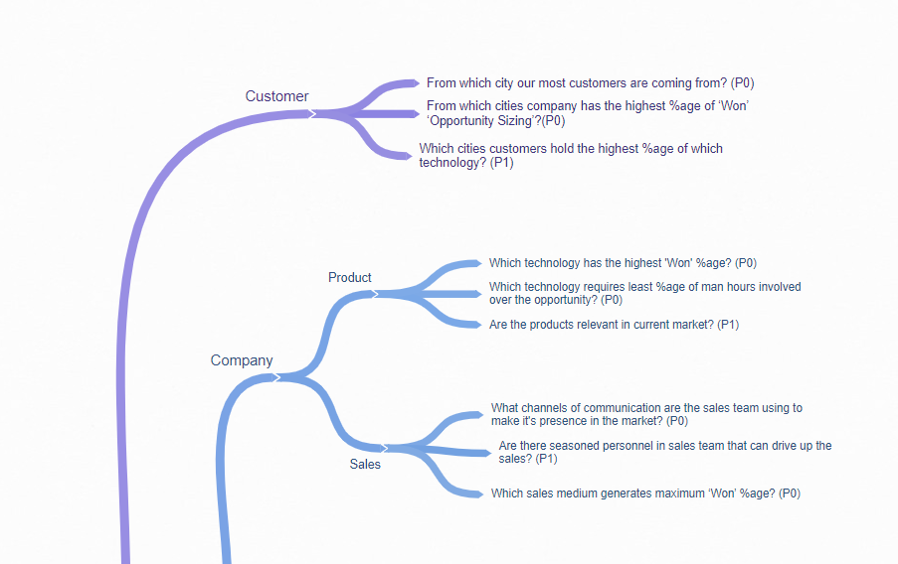
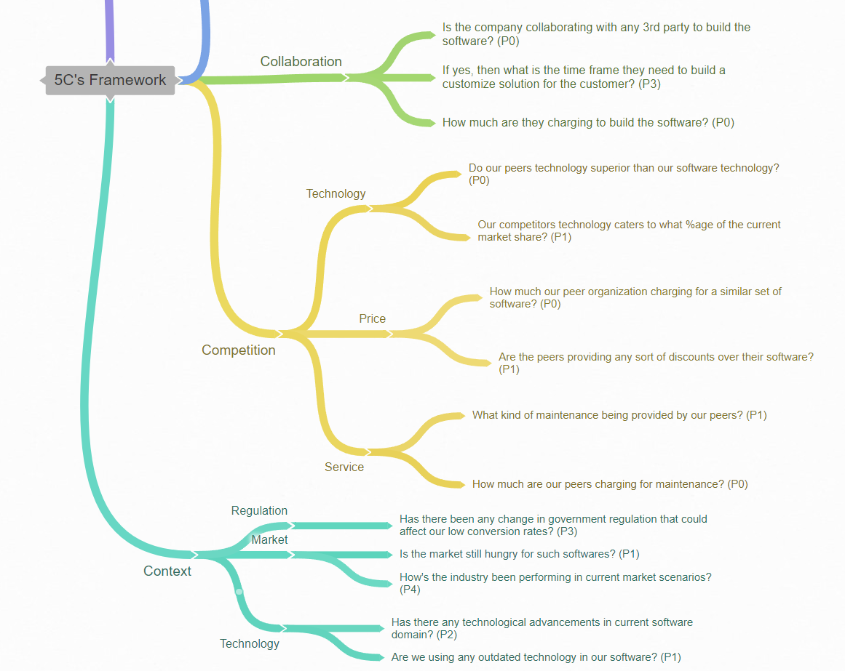
PART II : Formulating Hypotheses Sales Pipeline Conversion at a SaaS Startup
Provide the structure of the framework here
(You can attach the screenshot or multiple screenshots depending on the clarity of the image)
Notes:
Use the “download as” feature of Coggle if you are using the tool.
Provide one image with complete tree along with separate elements where the text is readable.
Copy the slide if you require more space

Slide 7
PART II : Formulating Hypotheses Sales Pipeline Conversion at a SaaS Startup
Branch 1
Customer:
From which cities, company has the highest number of customers?(P0)
From which cities, company has the highest %age of ‘Won’ ‘Opportunity Sizing’?(P0)
Which cities customers hold the highest %age of which technology? (P1)
Branch 2
Company:
Sub-Branch 1: Product
Which technology has the highest 'Won' %age? (P0)
Which technology requires least %age of man hours involved over the opportunity? (P0)
What opportunity sizing brings in the highest ‘Won’ %age from the set of technologies? (P1)
Notes:
Each branch must follow this naming pattern: Problem – Branch 1 – Sub-branch 1 – Sub-branch 2 – …… – Hypotheses
There must be minimum 10 hypotheses in total and at least 1 in each branch.

Slide 8
PART II : Formulating Hypotheses Sales Pipeline Conversion at a SaaS Startup
Branch 2
Sub-Branch 2: Sales
What channels of communication are the sales team using to make its presence in the market? (P0)
Which sales medium generates maximum ‘Won’ %age?
Which sales medium has the highest sales velocity?
Branch 3
Collaboration:
Is company collaborating with any 3rd party to build the software? (P0)
If yes, then what’s the time frame they need to build a customize solution for the customer? (P1)
What costs incur to Technoserve to build the software from a 3rd party organization?(P0)
Notes:
Each branch must follow this naming pattern: Problem – Branch 1 – Sub-branch 1 – Sub-branch 2 – …… – Hypotheses
There must be minimum 10 hypotheses in total and at least 1 in each branch.

Slide 9
PART II : Formulating Hypotheses Sales Pipeline Conversion at a SaaS Startup
Branch 4
Competition
Sub-Branch 1: Technology
Is our peer's technology superior to our software technology? (P0)
Our competitor's technology caters to what percentage of the current market share? (P0)
Branch 4
Sub-Branch 2: Price
How much our peer organization charging for a similar set of software? (P0)
Are the peers providing any sort of discounts over their software? (P1)
Notes:
Each branch must follow this naming pattern: Problem – Branch 1 – Sub-branch 1 – Sub-branch 2 – …… – Hypotheses
There must be minimum 10 hypotheses in total and at least 1 in each branch.

Slide 10
PART II : Formulating Hypotheses Sales Pipeline Conversion at a SaaS Startup
Branch 4
Sub-Branch 3: Service
What kind of service maintenance are being provided by our peers? (P1)
How much are our peers charging for maintenance? (P0)
Branch 5
Context
Sub-Branch 1: Regulation
Has there been any change in government regulation that could affect our low conversion rates? (P3)
Notes:
Each branch must follow this naming pattern: Problem – Branch 1 – Sub-branch 1 – Sub-branch 2 – …… – Hypotheses
There must be minimum 10 hypotheses in total and at least 1 in each branch.

Slide 11
PART II : Formulating Hypotheses Sales Pipeline Conversion at a SaaS Startup
Branch 5
Sub-Branch 2: Market
Is the market still hungry for such software? (P1)
How's the industry been performing in current market scenarios? (P4)
Branch 5
Sub-Branch 3: Technology
Has there any technological advancements in current software domain? (P2)
Are we using any outdated technology in our software? (P1)
Notes:
Each branch must follow this naming pattern: Problem – Branch 1 – Sub-branch 1 – Sub-branch 2 – …… – Hypotheses
There must be minimum 10 hypotheses in total and at least 1 in each branch.

Slide 12
PART III A : Generating Insights Sales Pipeline Conversion at a SaaS Startup
Variable
City
B2B Sales Medium
Opportunity Status
Technology Primary
Opportunity Sizing
Business From Client
Insights if any
Cities with highest potential revenue
Sales medium that has the highest conversion rates
All insights offer the opportunity status conversion rates
Top technologies with higher conversion rates
Clients with most potential revenue with highest conversion rates
Mumbai brings in the highest number of business from client in last fiscal year (FY 2017-18) across all the categories of business amount
Pattern of Insight
Significant Outliers
Surprising Comparison
Surprising Comparison
Significant Outliers
Surprising Comparison
Surprising Comparison
Notes:
Analyse the variables in the dataset, find the insights and mention the pattern of insights in the data. Make more copies of this slide if needed.

Slide 13
PART III A : Generating Insights Sales Pipeline Conversion at a SaaS Startup
Variable under consideration: City
Notes:
For each variable that produced an interesting insight, explain your analysis bit here – the results you got from excel and the necessary visualisations. Note: it is compulsory for you to mention the results of the analysis on these variables - 'Technology Primary', 'B2B Sales Medium', 'Client Revenue Sizing', 'Opportunity Sizing' and 'Business from Client last year’.

Slide 14
PART III A : Generating Insights Sales Pipeline Conversion at a SaaS Startup
Variable under consideration: B2B Sales Medium
Notes:
For each variable that produced an interesting insight, explain you analysis bit here – the results you got from excel and the necessary visualisations. Note: it is compulsory for you to mention the results of the analysis on these variables - 'Technology Primary', 'B2B Sales Medium', 'Client Revenue Sizing', 'Opportunity Sizing' and 'Business from Client last year’.

Slide 15
PART III A : Generating Insights Sales Pipeline Conversion at a SaaS Startup
Variable under consideration: Technology Primary
Notes:
For each variable that produced an interesting insight, explain you analysis bit here – the results you got from excel and the necessary visualisations. Note: it is compulsory for you to mention the results of the analysis on these variables - 'Technology Primary', 'B2B Sales Medium', 'Client Revenue Sizing', 'Opportunity Sizing' and 'Business from Client last year’.

Slide 16
PART III B : Presenting Findings Sales Pipeline Conversion at a SaaS Startup
Notes:
You are free to use the elements and boxes mentioned previously. Make sure you’re using the pyramid principle, data visualization, visual design principle and storyboarding concepts to design these slides.

Slide 17
PART III A : Generating Insights Sales Pipeline Conversion at a SaaS Startup
Variable under consideration: Business from Client
Notes:
For each variable that produced an interesting insight, explain you analysis bit here – the results you got from excel and the necessary visualisations. Note: it is compulsory for you to mention the results of the analysis on these variables - 'Technology Primary', 'B2B Sales Medium', 'Client Revenue Sizing', 'Opportunity Sizing' and 'Business from Client last year’.

Slide 18
PART III A : Generating Insights Sales Pipeline Conversion at a SaaS Startup
Variable under consideration: Client Revenue Sizing
Notes:
For each variable that produced an interesting insight, explain you analysis bit here – the results you got from excel and the necessary visualisations. Note: it is compulsory for you to mention the results of the analysis on these variables - 'Technology Primary', 'B2B Sales Medium', 'Client Revenue Sizing', 'Opportunity Sizing' and 'Business from Client last year’. Make more copies of this slide if needed.

Slide 19
PART III A : Generating Insights Sales Pipeline Conversion at a SaaS Startup
Recommendations
Mumbai, with its highest conversion rate and potential revenue (outpacing the second-best city by a remarkable 10.72%), stands as the most promising revenue generator. It is closely followed by Delhi.
Amongst the development of cloud-based software, ERP Implementation technology not only requires the lowest man hours but also boasts the highest conversion rate at 50.02%, nearly double that of Technical Business Solutions, which stands at 23.44%
While the Marketing sales medium generates a larger volume of leads, the Enterprise sellers achieve a 3.41% higher conversion rate.
Corresponding Insights
Notes:
For each recommendation explain the insights that form the reasoning for giving that recommendation. Make more copies of this slide if necessary.

Slide 20
PART III B : Presenting Findings Sales Pipeline Conversion at a SaaS Startup
We have the potential to increase conversion rates
The primary emphasis should be on serving clients located in Mumbai and Delhi for most of our operations.
Mumbai boasts a conversion rate of 30.25%, surpassing the second-highest by an impressive10.72%.
Last year, Mumbai led the way by securing the highest percentage share of business at 26.94%, surpassing the second-highest which is Delhi by an impressive 7.53%.Bengaluru closely followed in the rankings
Implementing ERP technologies and offering technology-based solutions yield the highest conversion rates
ERP Implementation technology boasts the highest conversion rate at 14.90%, nearly doubling the second-highest, which stands at 7.50% and is associated with Technical Business Solutions
ERP Implementation technology dominates the client's share of business, commanding a remarkable 63.84%, followed by Technical Business Solutions at 35.02%. Collectively, Legacy Modernization and Analytics contribute a combined share of just 1.14%
Notes:
You are free to use the elements and boxes mentioned previously. Make sure you’re using the pyramid principle, data visualization, visual design principle and storyboarding concepts to design these slides.

